Slide 1
Angel investment in the U.S. – trends & best practices
September 26, 2016
Marianne Hudson

Slide 2
Topics in my presentation
Update on Angel Capital Association
The American startup & expansion funding scene
Stats and trends in American angel investing
Best (or maybe good?) practices in angel investing
Resources ACA offers to global early-stage community

Slide 3
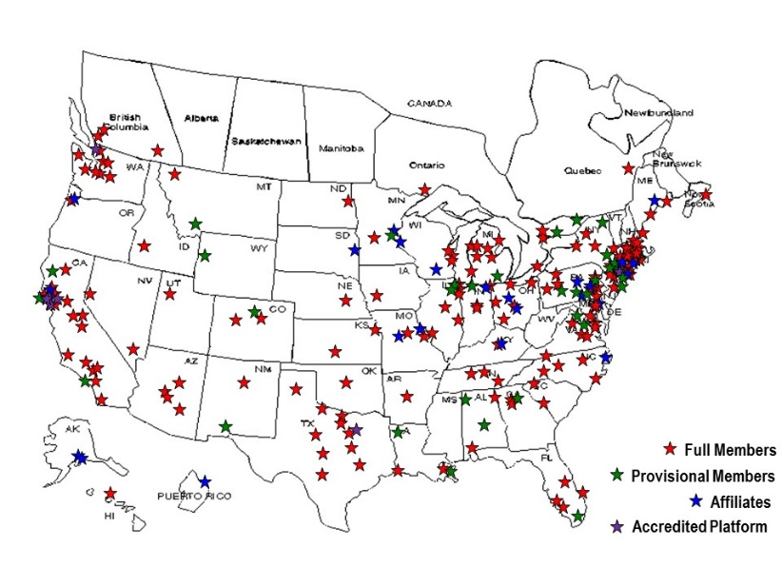
Angel capital association today
World’s largest association of accredited angel investors
www.angelcapitalassociation.org
13,000+ investors
Angel groups
Accredited platforms
Family offices
Individual angels
250+ organizations
Every U.S. state & 5 Canadian provinces
Mission: fuel success of angel groups and accredited investors, as well as the early-stage companies they support

Slide 4




















Members are top groups & platforms
New Dominion Angels

Slide 5









Aca members fund great companies, exits

Slide 6
ANGELs fund high-growth companies
Number of Employees One Year After ACA Member Investment
Average = 41.4
Median = 17.5
Source: ACA research on member investments, March 2015

Slide 7
Key American angel stats (estimates)
2015 National Market
71K+
deals
in every state
$24B
invested
~300,000 angels
90% of outside equity for startups
of
Averages
Individual check size
$10 - $50K
Market deal size
$345K
Group deal size
$850K
Market Valuation
$2.7M
Group Valuation
$4+M

Slide 8
Angels Fund Majority of Startups
Angel Investors
Venture Capital
$24.6 billion
71,000 deals
17,750 seed
31,950 early stage
19,170 expansion
305,000 individuals
$59.1 billion*
4,380 deals
186 seed
2,219 early stage
1,975 later/expansion
718 active firms
Sources: “Angel Investing Market for 2015, Center for Venture Research/ UNH;
NVCA 2016 Yearbook; PwC MoneyTree
*(12 expansion-stage companies accounted for more than $10 B of this total)

Slide 9
ANGEL VS VC INVESTMENT SIZE AND VALUATION
Angel Investors
Venture Capital
Total Invested
$24.6 billion
71,000 deals
$2.6M
$347K
$59.1 billion*
4,361 deals
$5.1M
$13.6M
Total Deals
Average Seed/Early Stage Pre-Money Valuation
Average Investment per deal (all deal sizes)
Sources: “Angel Investing Market for 2015, Center for Venture Research/ UNH; AngelList; NVCA 2015 Yearbook; PwC MoneyTree

Slide 10
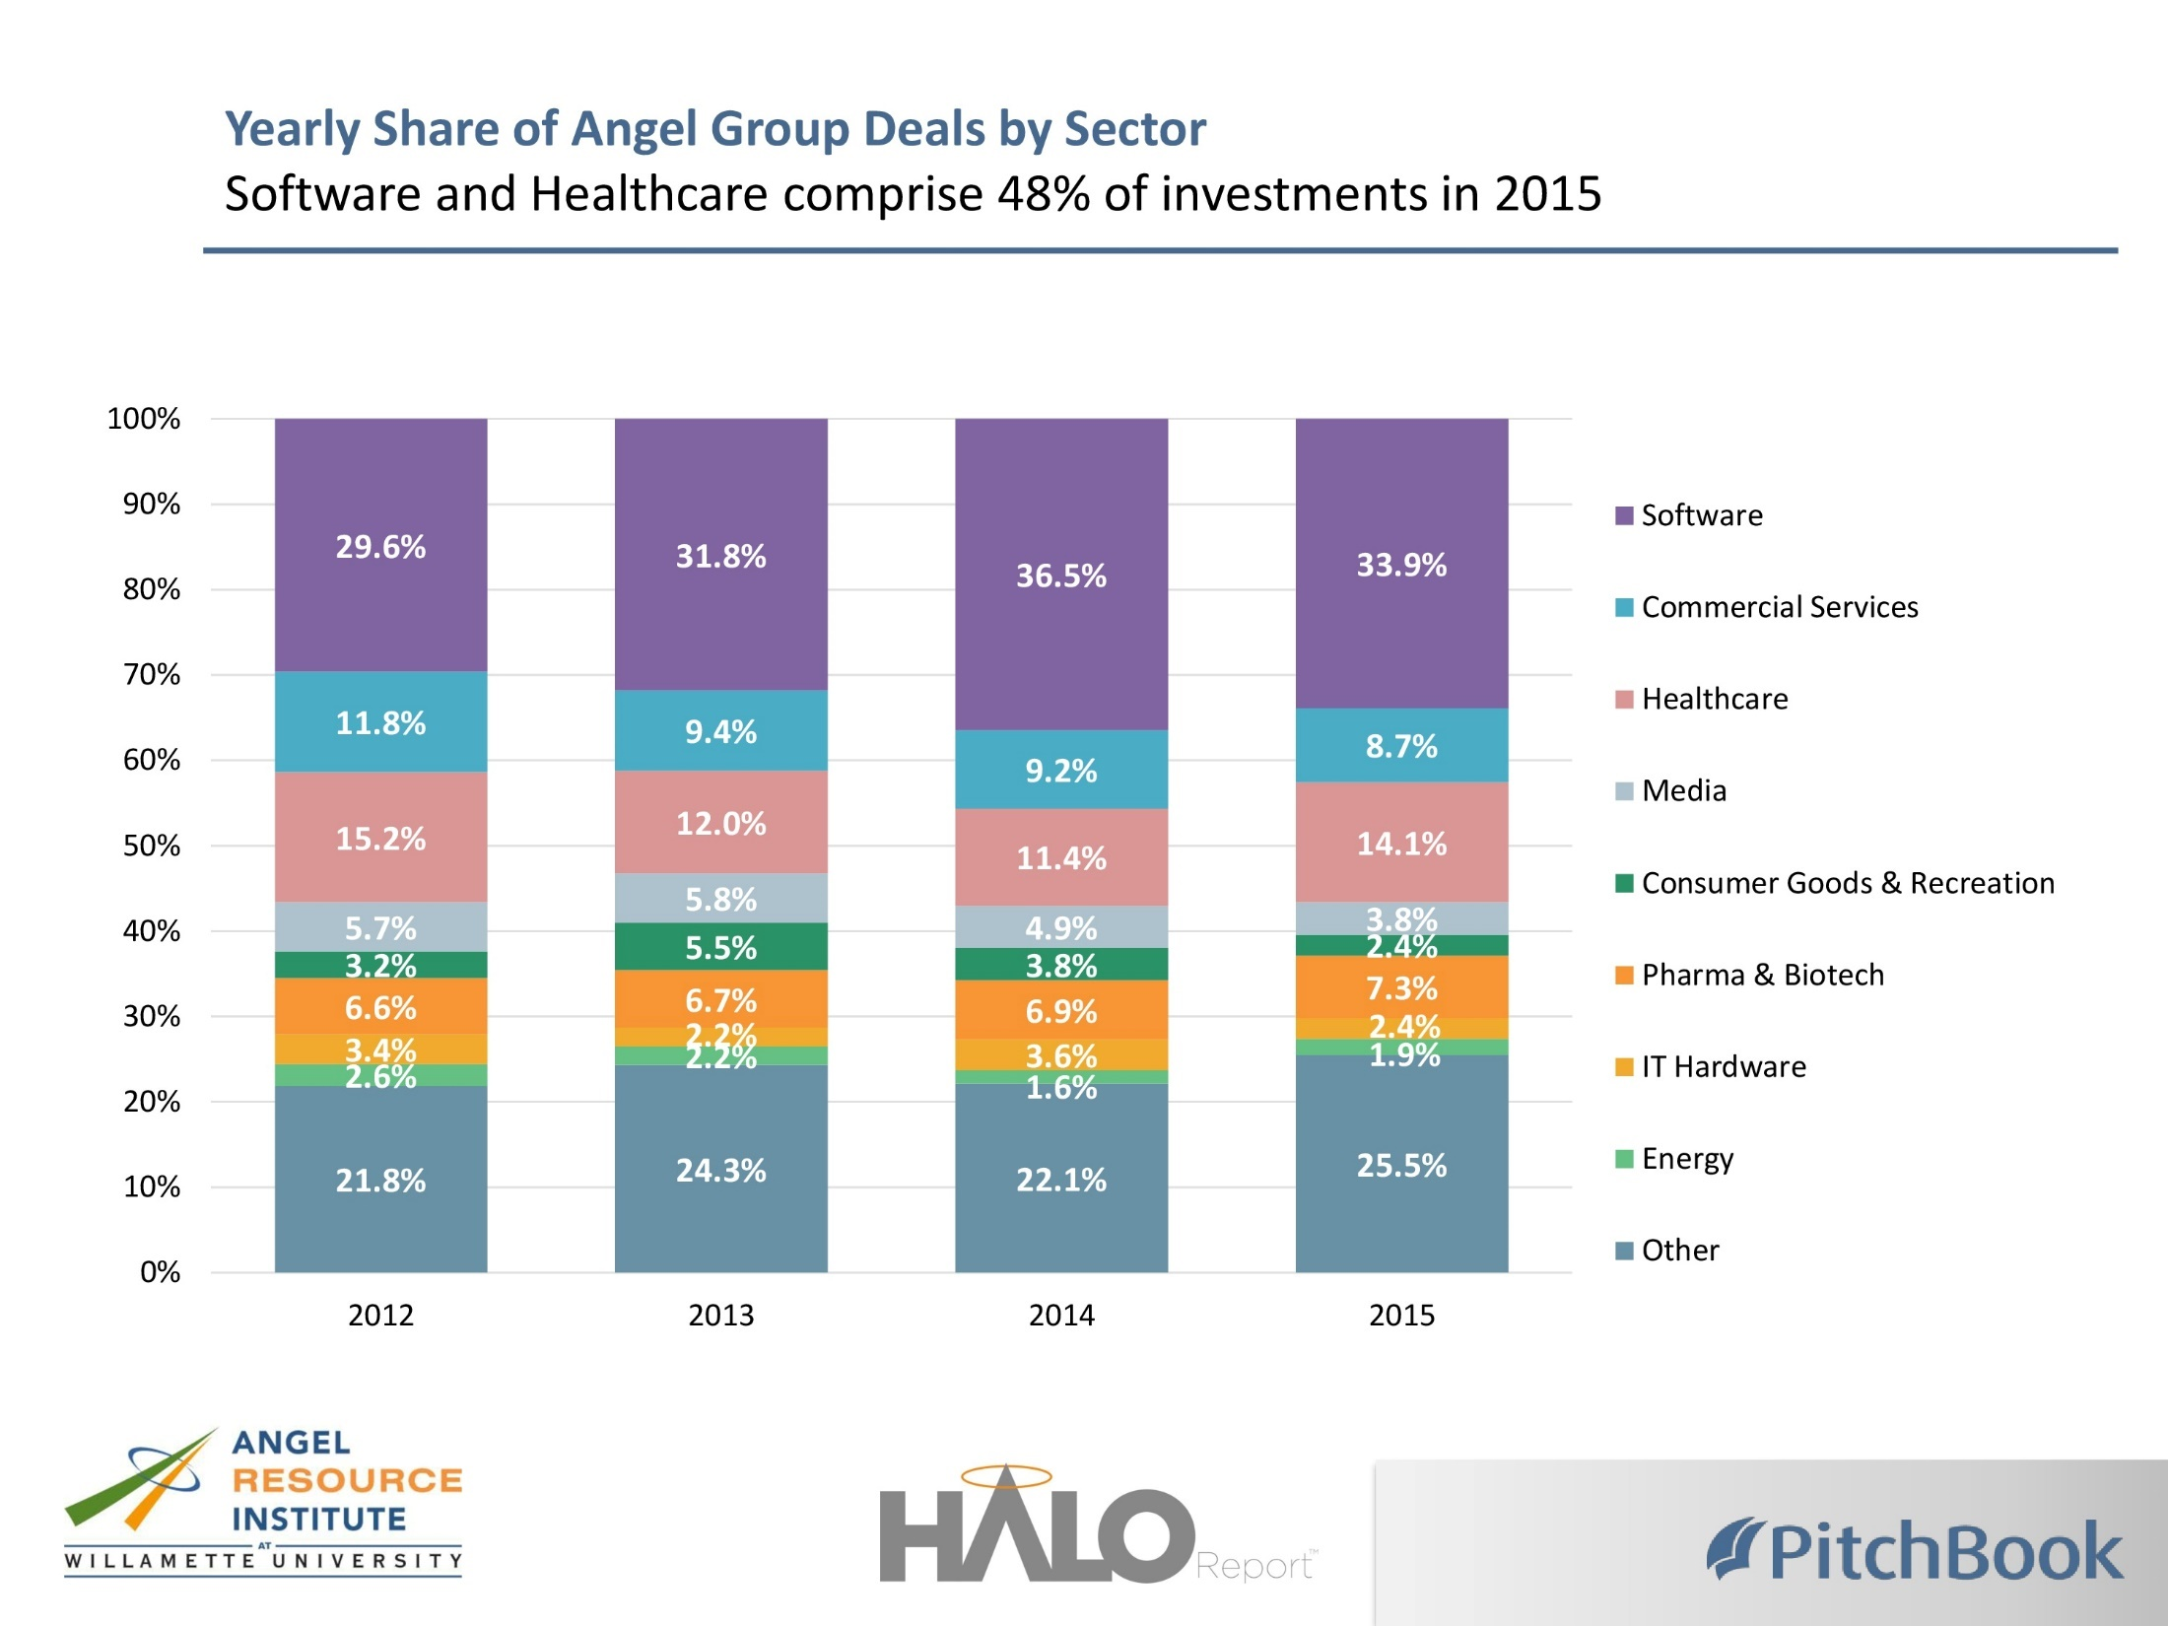

Slide 11
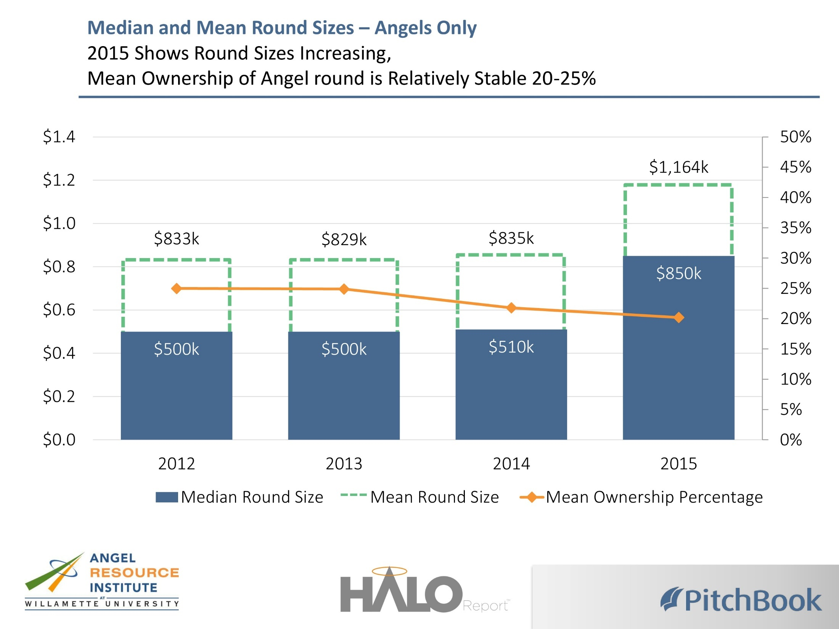

Slide 12
Multiple groups needed to fill rounds
67% of Angel Groups Invest $150K to $500K per Deal
Investment surprisingly broad
Average deal size increasing
Syndication needed among groups to fill rounds entrepreneurs need
Source: ACA Confidence Survey, 2012

Slide 13
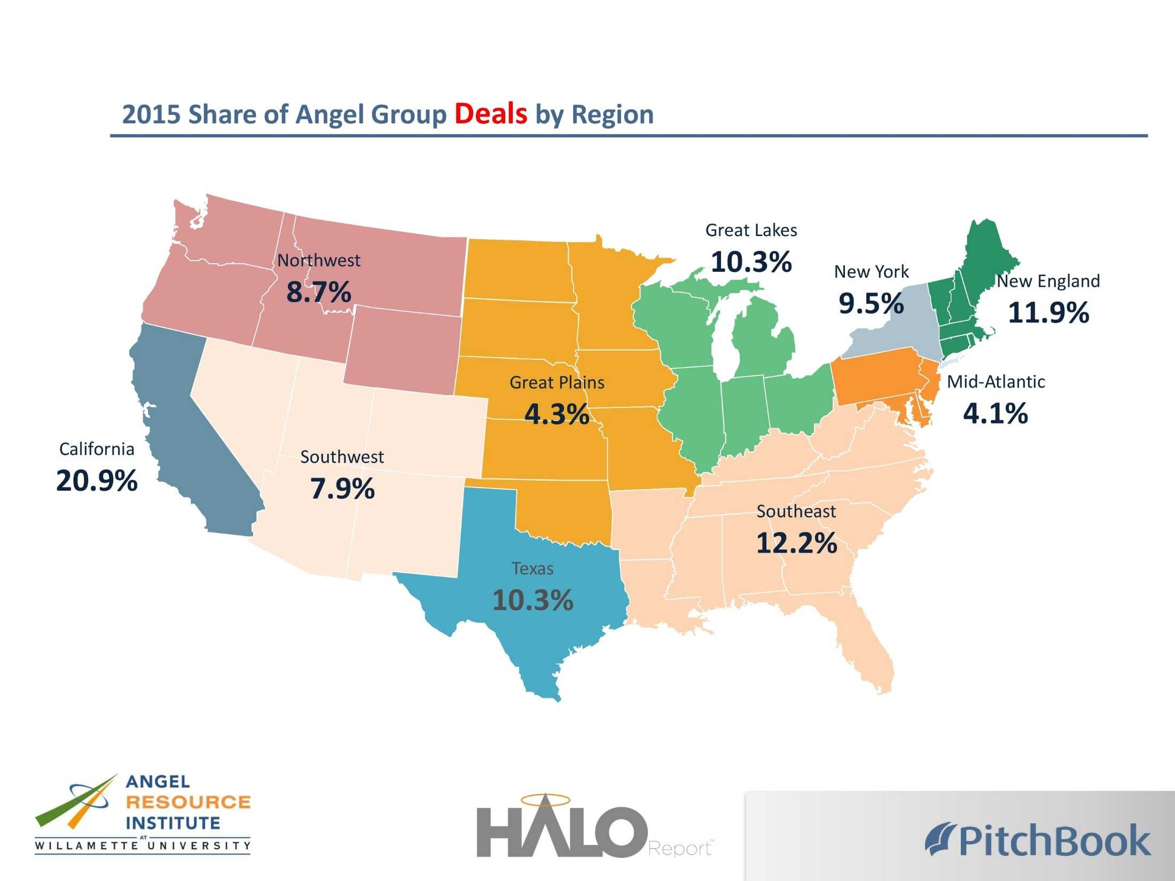

Slide 14
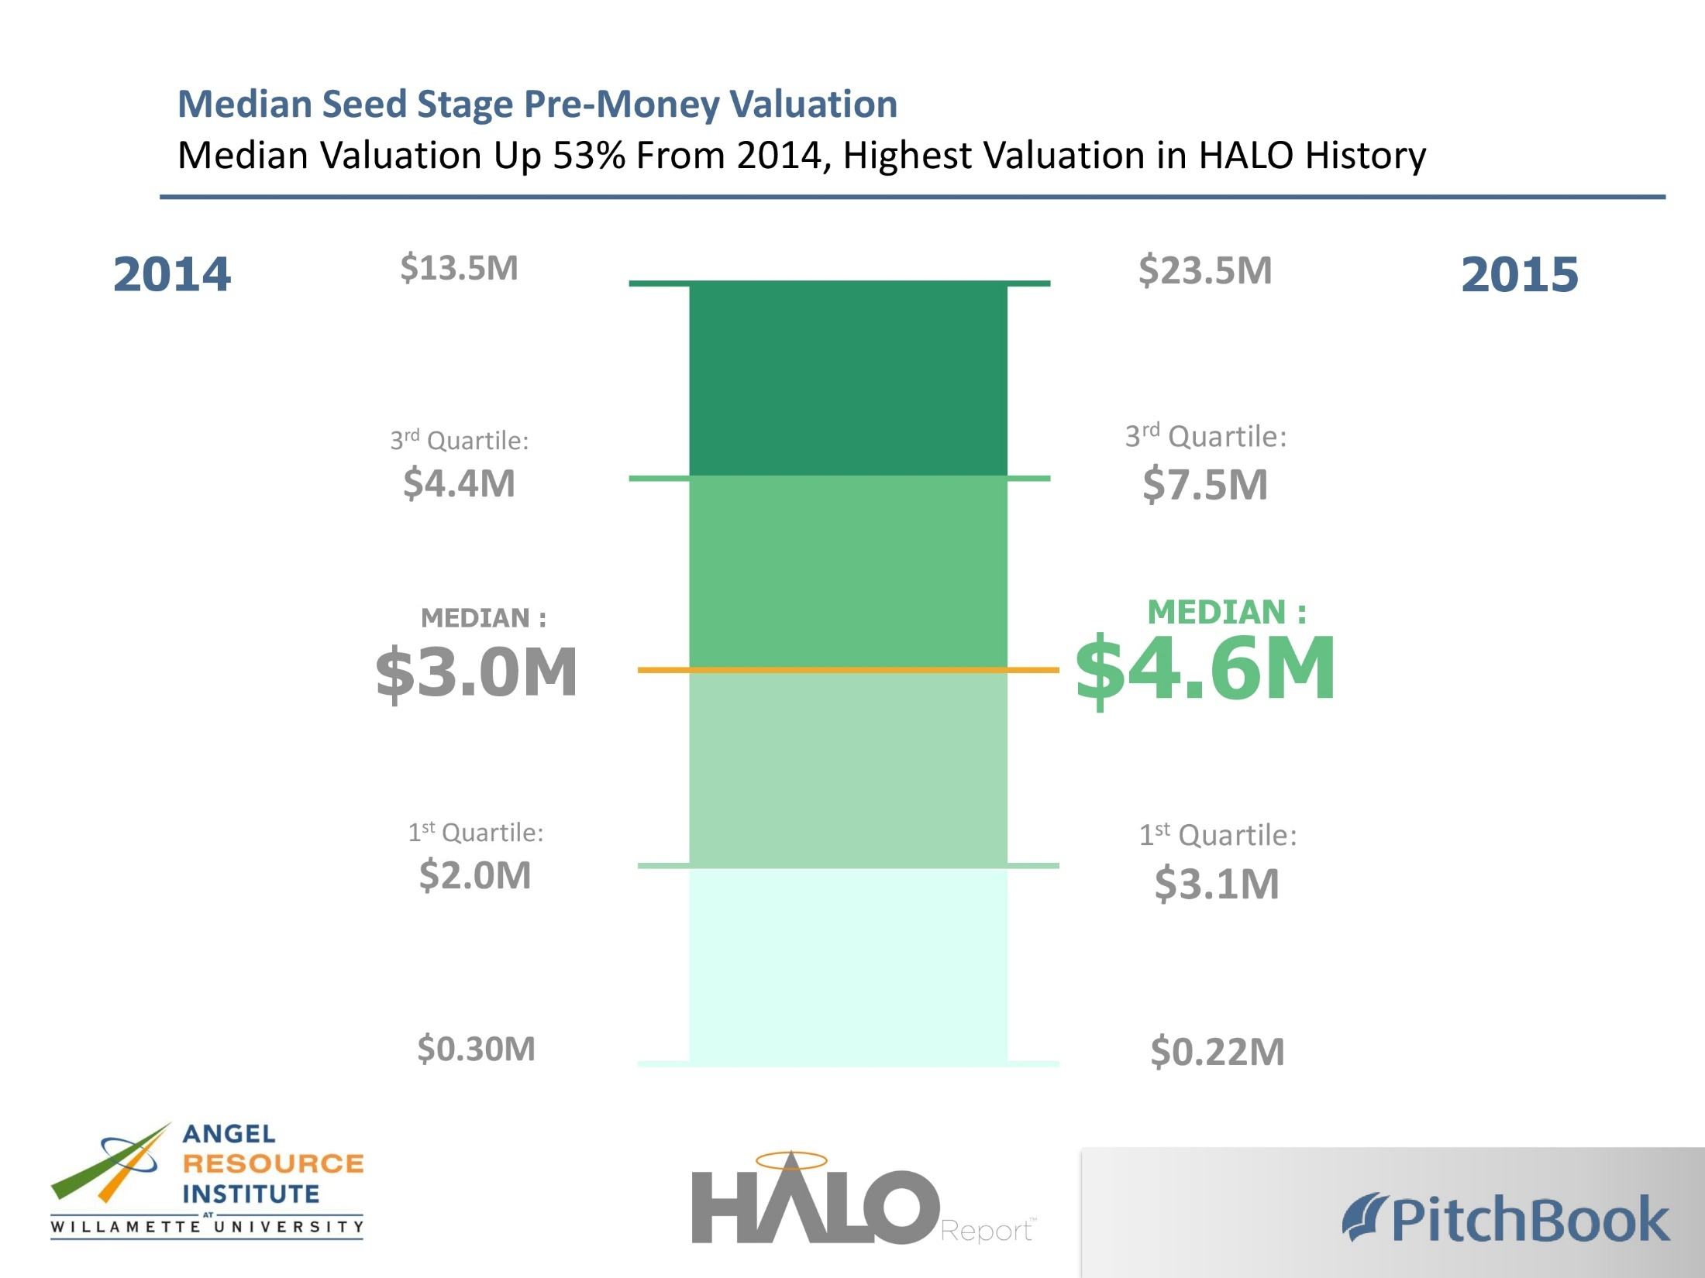

Slide 15
Many ways to invest
Large majority invest informally. Other options offer advantages in deal flow, sophistication, sharing of work, building portfolios, and connecting to more funding and exits. Also seed funds like 500 Startups.
Informal or Individual
(on own or with friends)
Online
(via accredited platforms)
Accelerator
(funds and/or connect through mentoring)
Angel Groups
(networks, funds or combination)

Slide 16
Angel groups vary by number of investors
Average = 68
Median = 50
% of Respondents
Number of Angels
Size of group membership has increased over time – average in 2012 was 52
Largest 20% of groups account for 49% of ACA member angel investors
Source: ACA Member Group Survey, March 2015 -106 groups reporting

Slide 17
…and also in deal activity
Number of Investments Per Group in 2014
Average = 10.3
Median = 7.0
Highest = 61
Deals per group
Source: ACA Member Group Survey, March 2015 -103 groups reporting

Slide 18
Groups also vary in amount invested
Total Investment Dollars Per Group in 2014
Average = $2.46M
Median = $1.24M
Highest = $16.34M
Source: ACA Member Group Survey, March 2015 -103 groups reporting

Slide 19

Diversity is increasing…we must do more!
Supporting women entrepreneurs
Focused on Veteran-owned businesses
Minority-focused investing
Under 30 angel investors
Number of angels that are women is increasing
Source: ACA Member Group Survey, March 2015 -106 groups reporting

Slide 20
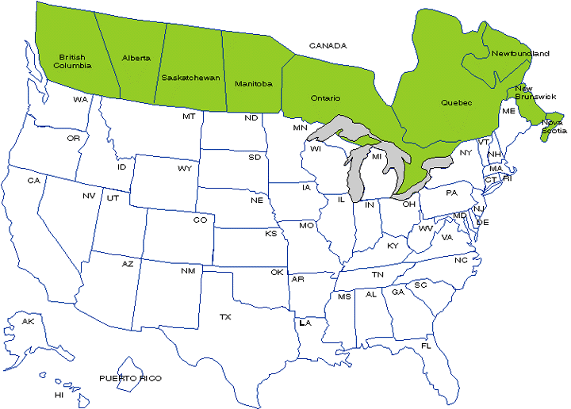
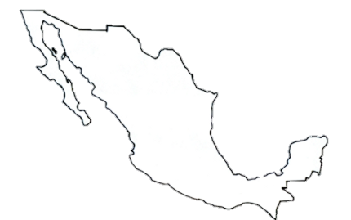
Aca groups by investment structure
Fund 16%
Network 63%
Network with Sidecar 12%
Other 9%
MEXICO
Source: ACA Member Group Survey, March 2015 -106 groups reporting

Slide 21
ANGEL FUNDS BY DOLLAR SIZE
Average: $7.1M
Median: $5.3M
Source: ACA Member Group Survey, March 2015 - 31 groups reporting

Slide 22
Big evolution: where groups invest
In what geography does your group prefer to invest?
In 2008, 63% preferred closer to home
In 2015, 54% invest in region or have no geography restrictions
Source: ACA Member Group Survey, March 2015 -106 groups reporting

Slide 23
Deal structure preferences
Strong preference for priced rounds and preferred stock
Some will do convertible debt
Most sectors: products developed and have customer traction
Valuation not only for sector but for location (not unlike real estate)
Board seat for significant investments
Most groups stay away from generally solicited offerings

Slide 24
Some investment practices that work
Portfolio strategy
Syndication
Focus not just on front end of investing, but on outcomes after the check
Investment structures – improvements to convertible debt
Online platforms for accredited investors
New models for angel groups, bringing in new angels – women, younger investors, etc.

Slide 25
Portfolio strategy
Risks & rewards of angel investing
3 yr
35% - 0X
Overall Multiple: 2.6X
Avg Holding Period: 3.5 years
3.3 yr
Average IRR: 27%
4.6 yr
4.9 yr
6 yr
Source: Returns of Angels in Groups, 2007

Slide 26

syndication
75% plus of ACA member deals are syndicated
Common agreements lead to sharing DD, fast track on group decisions
Come out of regular communication and trust building
Regularly include multiple angel groups, family offices, private equity
Only way to support companies where VCs are rare
$12M series B
Led by Golden Seeds
6 ACA member groups, across US
Plus many others

Slide 27

Focus before and after check
Picking good entrepreneurs is important, as is:
Negotiating good deals
Conducting due diligence
But, can you really tell which will be best in show?
Angels make, or lose most money, after investing:
  Dry powder, criteria next decisions
  Board of Directors (holding their feet to fire, CEO compensation)
  Minimizing losses (taxes, ensuring $ for closing businesses)
  Help with follow-on round investors and exits
  Keep track of cap tables and dilution

Slide 28
Investment structures – convertible debt
In survey a year ago, ACA members said:
  82% prefer priced equity round
  But 78% had done at least one convertible note round
  And 25% used convertible notes in < half of investments
Improvements to notes:
  Valuation cap for next (equity) round
  Setting discount for note holders – 20-30%
  SAFEs – not even including the debt part of the deal

Slide 29

Online investing – fill rounds, diversify
This means crowdfunding for angels, but not everyone

Slide 30



New models bring diversity, better decisions

Slide 31

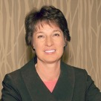

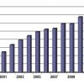


Aca resources available to you
Via www.angelcapitalassociation.org:
Webinars and Videos
Research, Best Practices
Timely Articles and Blogs
Sign up for Angel Insights Monthly Newsletter for news, new resources

Slide 32

Investors: come to 2017 aca summit
Join 700+ investors in San Francisco on April 26-28 to:
Share best practices in angel investing - deal sourcing, terms, supporting portfolio companies, syndication, and top exits
Discuss the latest data and trends in startup investing and different industry sectors
Hear keynote presentations from thought leading investors and entrepreneurs
Network with top angels from throughout North America and the world
Meet with corporate leaders to build relationships for investor portfolio companies and meet a limited number of interesting entrepreneurs

Slide 33
More information
Marianne Hudson
Angel Capital Association
+1 913-894-4700
mhudson@angelcapitalassociation.org
www.angelcapitalassociation.org
@ACAAngelCapital
www.forbes.com/sites/mariannehudson

Slide 34
Trends in US early-stage investing
“Unicorn thinking” led to problems, so downsizing in deals and valuations
Social networking – LinkedIn especially
Blending of angel groups and online investing (AngelList…)
Crowdfunding – product (Kickstarter), now equity
Accelerators
Cross-border investment (small amount)
Getting more women involved as investors & entrepreneurs
Government interest in job creation/ SMEs

Slide 35
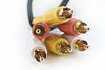










American startup ECOSYSTEM
Connect & collaborate
Support innovation & research
Get to markets for growth & exits
It starts with the entrepreneur
Experienced entrepreneurs & investors are critical
Seed the market if/ when necessary
Support startups & scaleups
Favorable taxes for startups, investors
Visibility is important
Rules balance capital formation & protection

Slide 36

Profile of Angel investors
Years investing 9
Number of investments 10
Total exits/ closures 2
Years as entrepreneur 14.5
Number ventures founded 2.7
Percent of wealth in angel investing 10%
Education Masters degree
Other backgrounds: corporate leaders, professional services
Source: Returns of Angels In Groups, Robert Wiltbank, Willamette University, published by Kauffman Foundation - 2007

