Slide 1
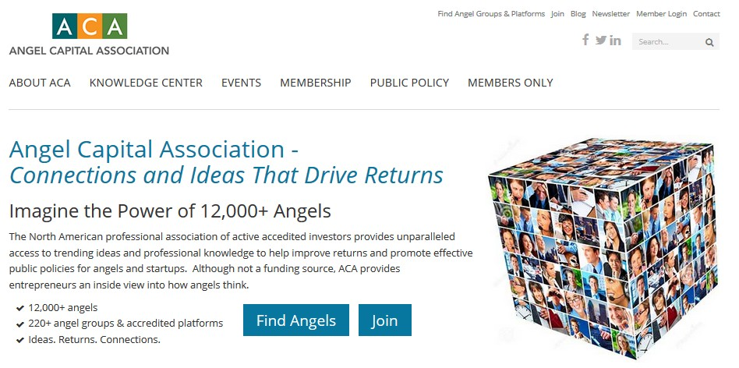
All Angels in ACA Groups are ACA Members
Sign up for eNews, invites, member access
www.angelcapitalassociation.org/newmember
Notes:
We invite you to use the many resources available for angels and entrepreneurs on our website.
Additional resources including an event library can be found in the Members Only Sectio

Slide 2
Contact ACA:
Questions & Answers
Staff Follow-up:
Marianne Hudson, Executive Director
Sarah Dickey, Membership Director
913-894-4700
mhudson@angelcapitalassociation.org
sdickey@angelcapitalassociation.org
www.angelcapitalassociation.org
@ACAAngelCapital

